Slide 1
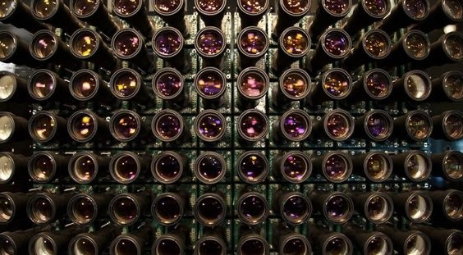
CS5187: Vision and Image
Multi-view stereo
Multi-Camera Array

Slide 2
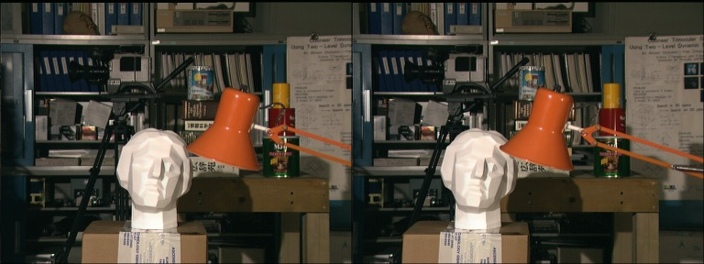
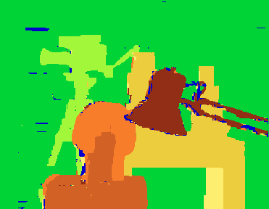
Before: Binocular (Two-View) Stereo
Left-right (rectified) stereo pair
Computed disparity map
Useful for robot perception and navigation, video effects, etc.

Slide 3

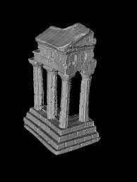

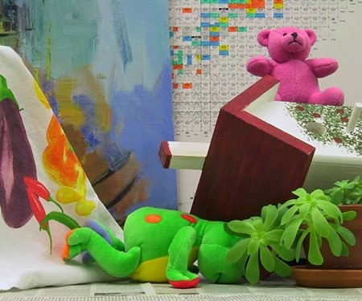
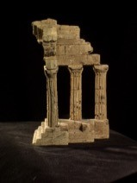

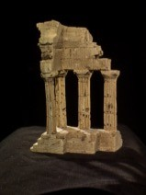
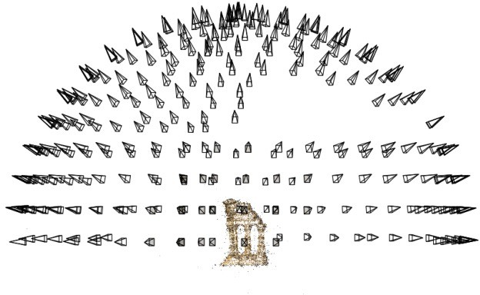

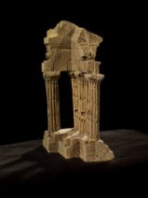

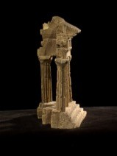
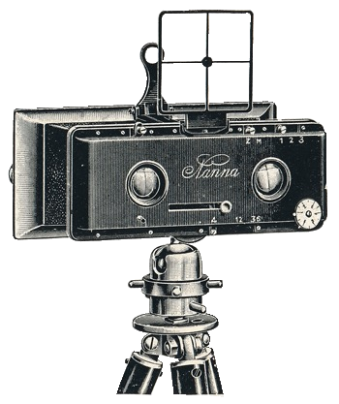

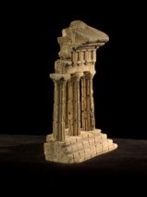
Now: Multi-view Stereo
Problem formulation: given several images of the same object or scene, compute a representation of its 3D shape
Binocular Stereo
Multi-view stereo

Slide 4
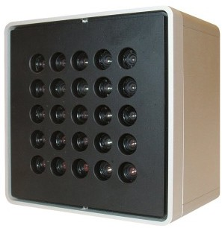
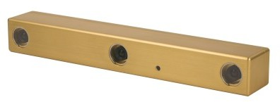
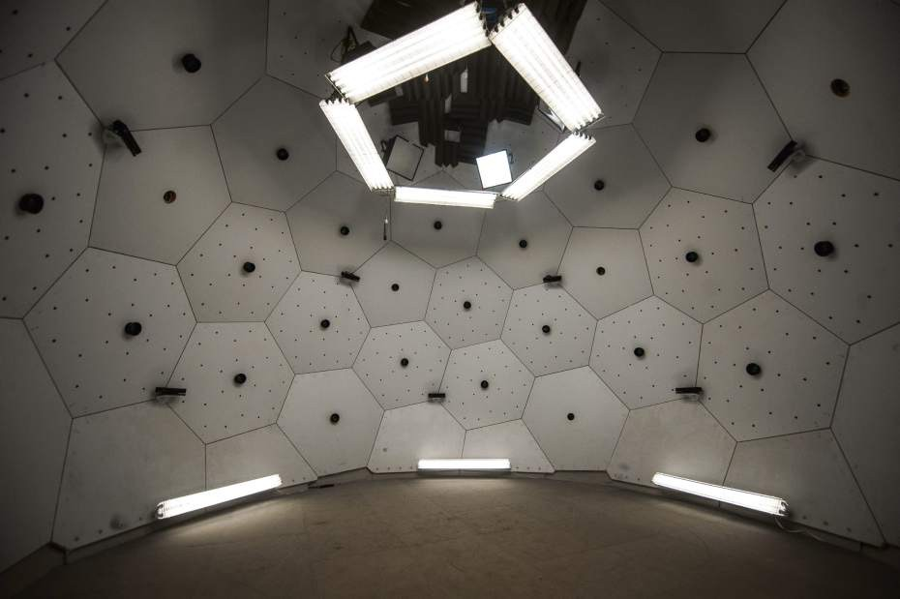
Multi-view Stereo
Point Grey’s Bumblebee XB3
Point Grey’s ProFusion 25
CMU’s Panoptic Studio

Slide 5
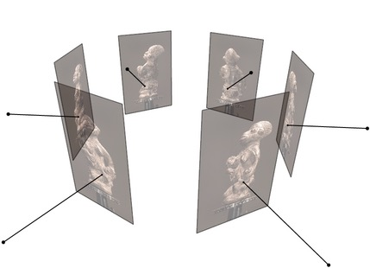
Multi-view Stereo
Input: calibrated images from several viewpoints (known intrinsics and extrinsics / projection matrices)
Output: 3D object model
We’ll talk more about how to calibrate multiple cameras soon
Figures by Carlos Hernandez

Slide 6
Applications

Slide 7
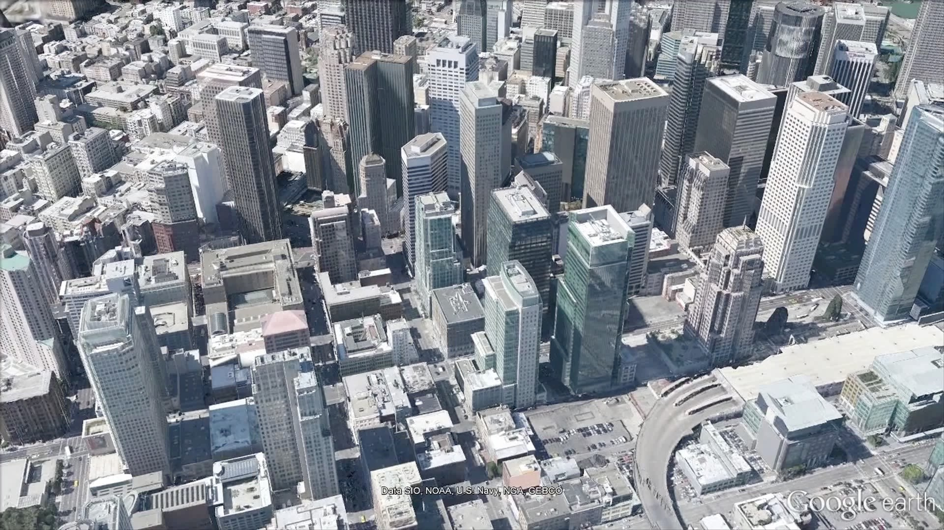

Slide 8
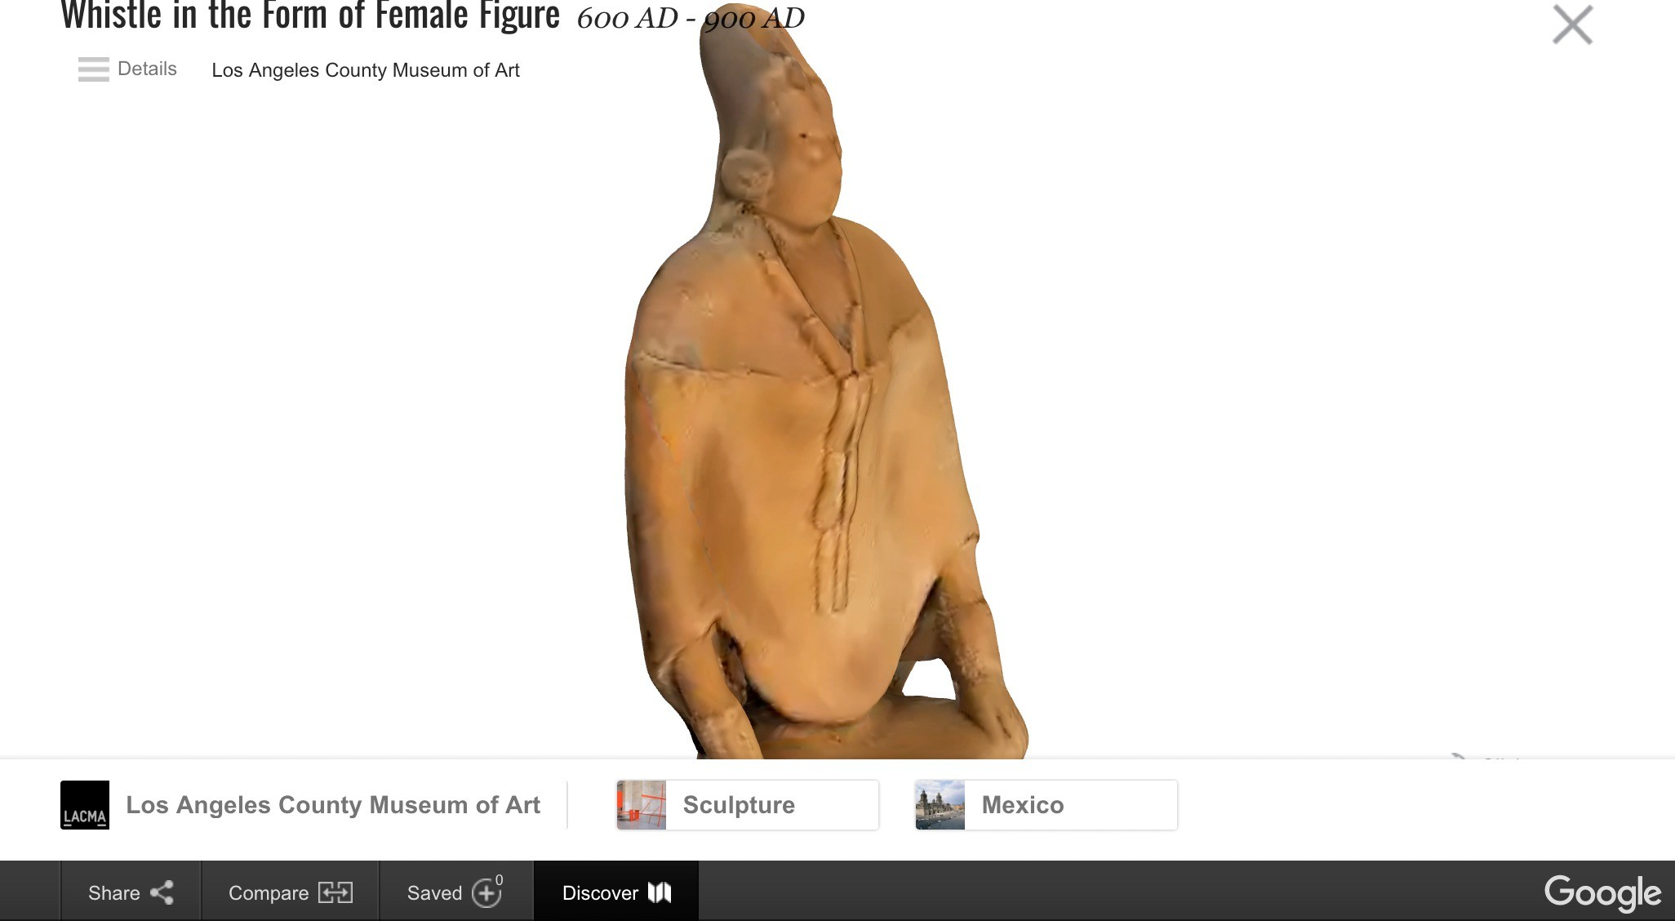

Slide 9

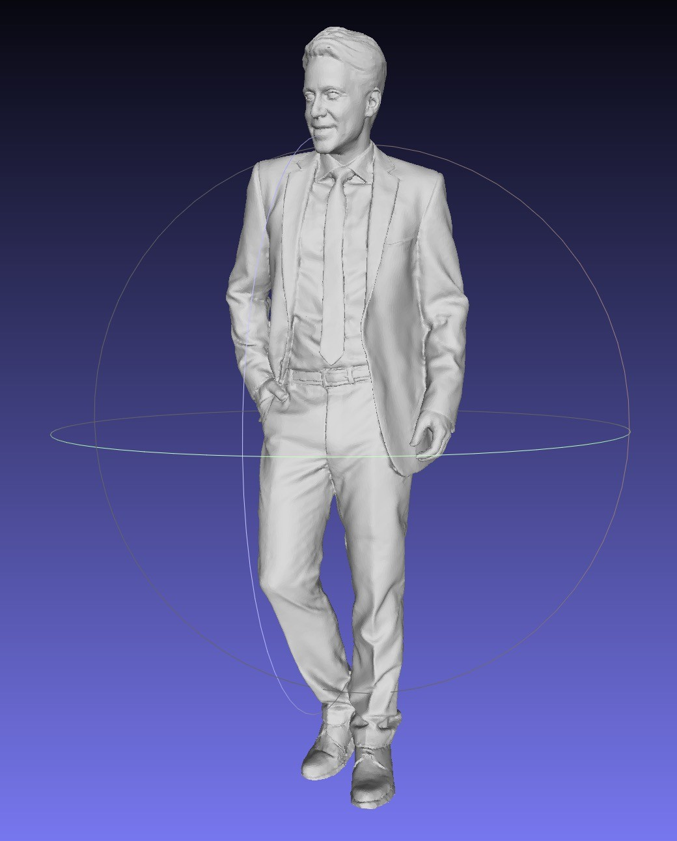
https://renderpeople.com/about-us/

Slide 10
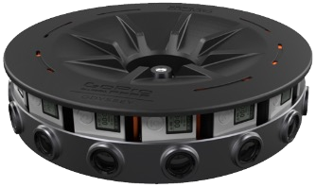
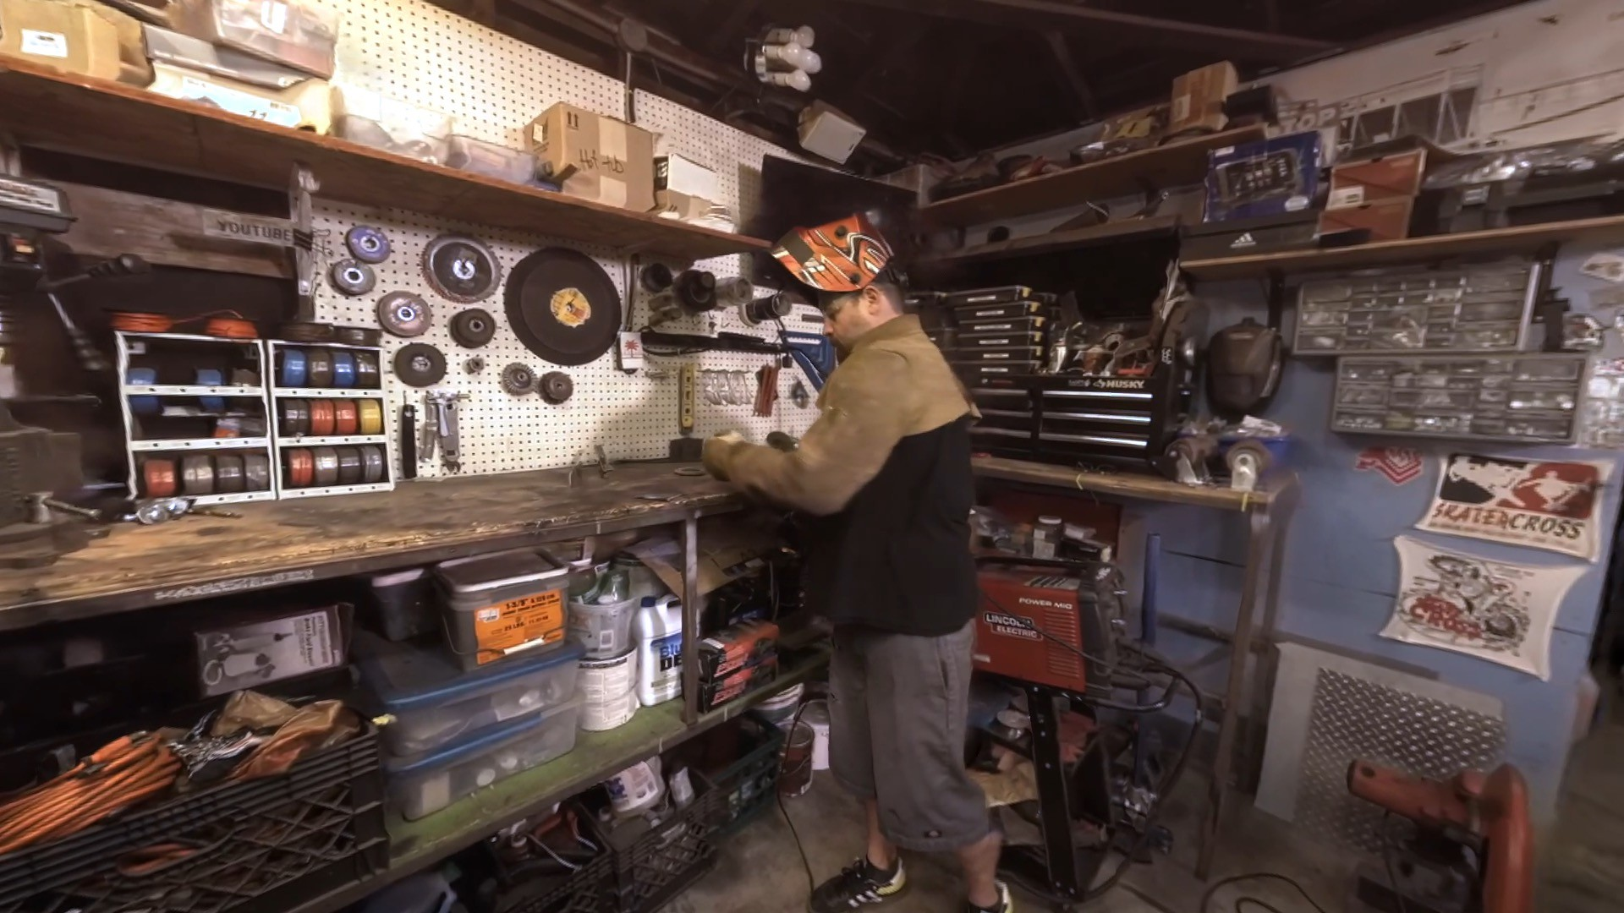
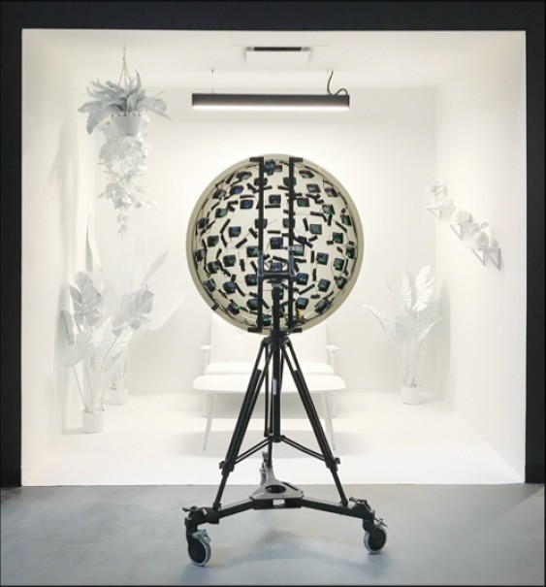
Application: Virtual Reality Video
Anderson, et al. Jump: Virtual Reality Video. SIGGRAPH Asia 2016.
Broxton, et al. Immersive Light Field Video with a Layered Mesh Representation. SIGGRAPH 2020.

Slide 11
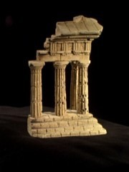
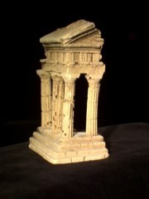

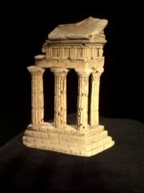
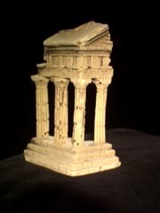
Multi-view stereo: Basic idea
reference view
neighbor views
Source: Y. Furukawa

Slide 12
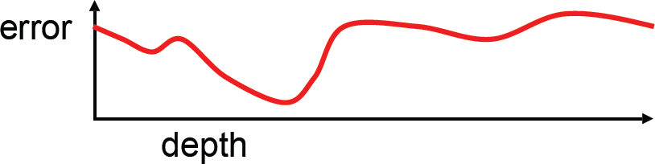
Multi-view stereo: Basic idea
reference view
neighbor views
Source: Y. Furukawa

Slide 13
Multi-view stereo: Basic idea
reference view
neighbor views
Source: Y. Furukawa

Slide 14
Multi-view stereo: Basic idea
reference view
neighbor views
In this manner, solve for a depth map over the whole reference view
Source: Y. Furukawa

Slide 15
Multi-view stereo: advantages
Can match windows using more than 1 neighbor, giving a
stronger match signal
If you have lots of potential neighbors, can choose the best subset of neighbors to match per reference image
Can reconstruct a depth map for each reference frame, and the merge into a complete 3D model

Slide 16
Choosing a single stereo baseline
all of these points project to the same pair of pixels
width of a pixel
Large Baseline Small Baseline
What’s the optimal baseline?
Too small: large depth error
Too large: difficult search problem

Slide 17
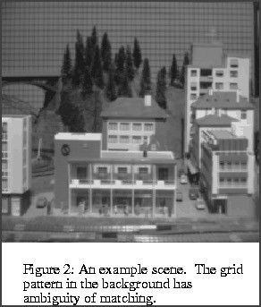
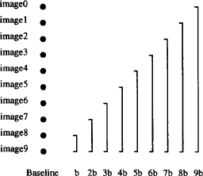
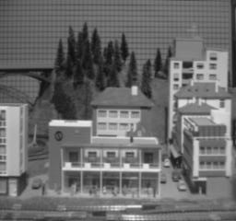

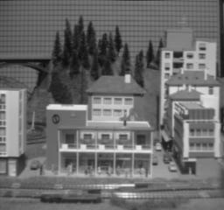
The Effect of Baseline on Depth Estimation
I₁
I₂
I10

Slide 18


Multiple-baseline stereo – all cameras in a row
z
pixel matching score
width of a pixel
For short baselines, estimated depth will be less precise due to narrow triangulation
z
For larger baselines, must search larger area in second image
width of a pixel
M. Okutomi and T.Kanade, “A Multiple-Baseline Stereo System,” IEEE Trans. on Pattern Analysis and Machine Intelligence, 15(4):353-363 (1993).

Slide 19
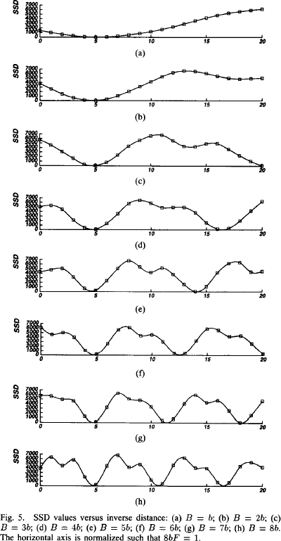
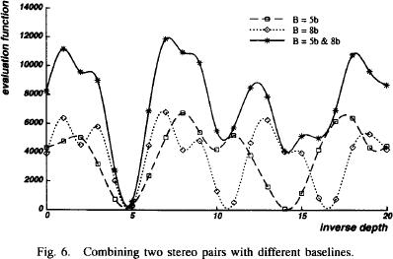
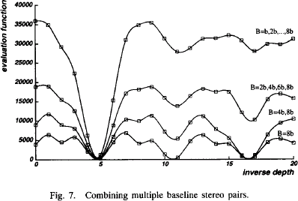

Slide 20
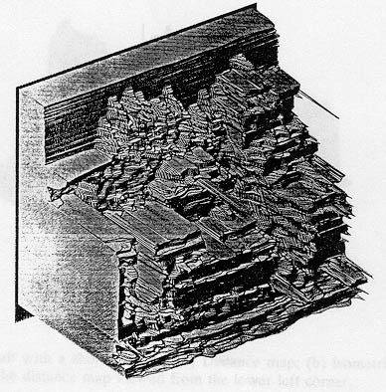
Multiple-baseline stereo results
I1
I2
I10
M. Okutomi and T. Kanade, A Multiple-Baseline Stereo System, IEEE Trans. on Pattern Analysis and Machine Intelligence, 15(4):353-363 (1993).

Slide 21
Multibaseline Stereo
Basic Approach
Choose a reference view
Use your favorite stereo algorithm BUT
  replace two-view SSD with SSSD over all baselines
  SSSD: the SSD values are computed first for each pair of stereo images, and then add all together from multiple stereo pairs.
Limitations
Only gives a depth map (not an “object model”)
Won’t work for widely distributed views.

Slide 22
Problem: visibility
Some Solutions
Match only nearby photos [Narayanan 98]
Use NCC instead of SSD,
Ignore NCC values > threshold [Hernandez & Schmitt 03]

Slide 23
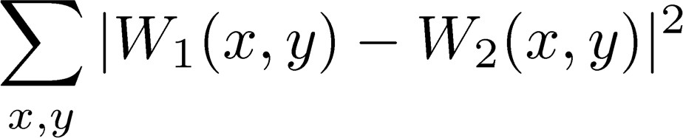
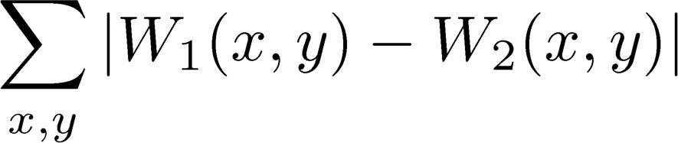
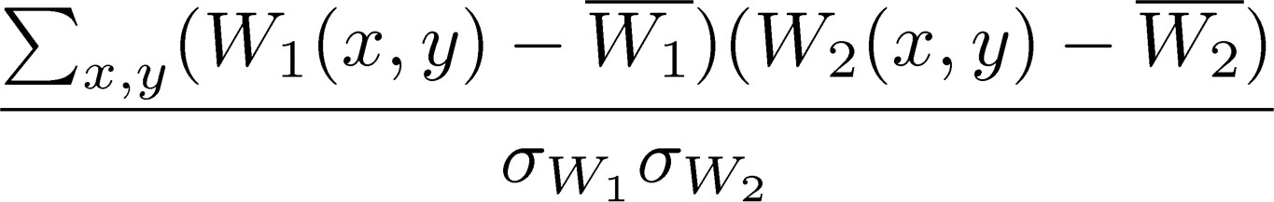
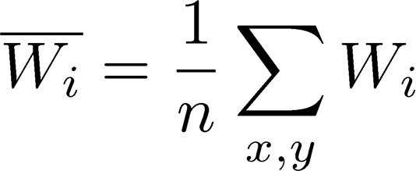
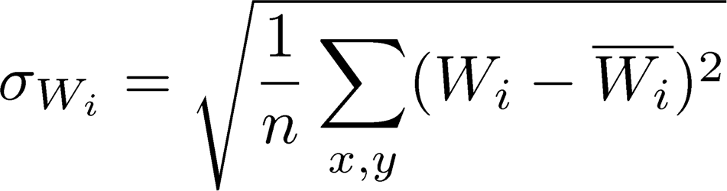
Popular matching scores
SSD (Sum of Squared Differences)
SAD (Sum of Absolute Differences)
ZNCC (Zero-mean Normalized Cross Correlation)
where
what advantages might NCC have?

Slide 24
Questions?

Slide 25
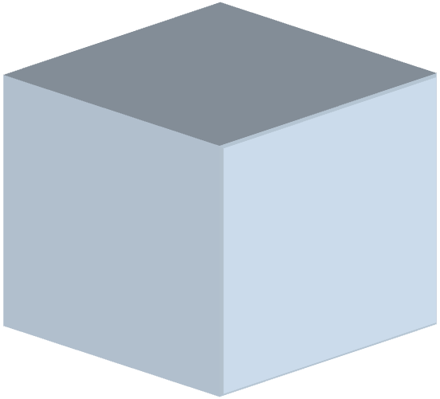
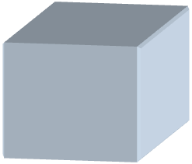
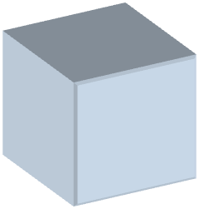
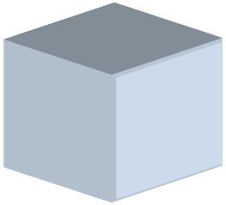
Plane-Sweep Stereo
Camera 1
R₁,t₁
Camera 3
R₃,t₃
Camera 2
R₂,t₂

Slide 26

Plane-Sweep Stereo
Proposed point at correct depth
Photo-consistent projections
Camera 1
R₁,t₁
Camera 3
R₃,t₃
Camera 2
R₂,t₂

Slide 27

Plane-Sweep Stereo
Proposed point at incorrect depth
Photo-inconsistent projections
Camera 1
R₁,t₁
Camera 3
R₃,t₃
Camera 2
R₂,t₂

Slide 28
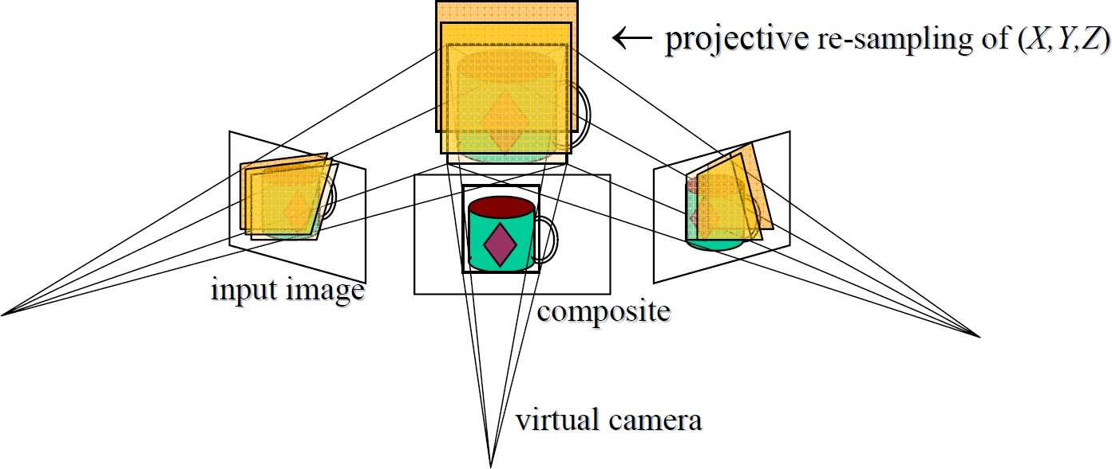
Plane-Sweep Stereo
Sweep family of planes parallel to the reference camera image plane
Reproject neighbors onto each plane (via homography) and compare reprojections
neighbor camera 1
neighbor camera 2
reference camera

Slide 29




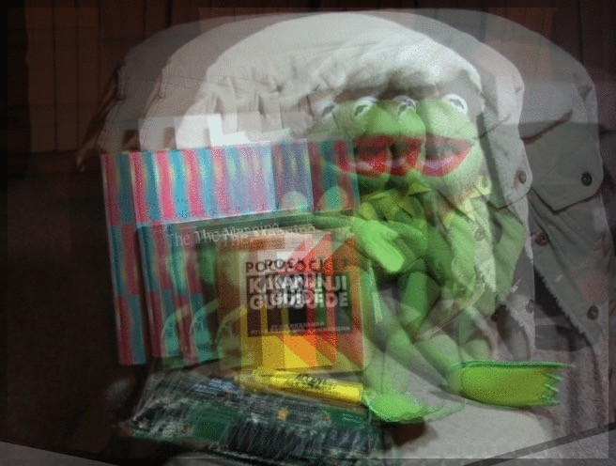

Plane-Sweep Stereo
Left neighbor
Reference image
Right neighbor
Left neighbor projected into reference image
Average images on each plane
Right neighbor projected into reference image

Slide 30
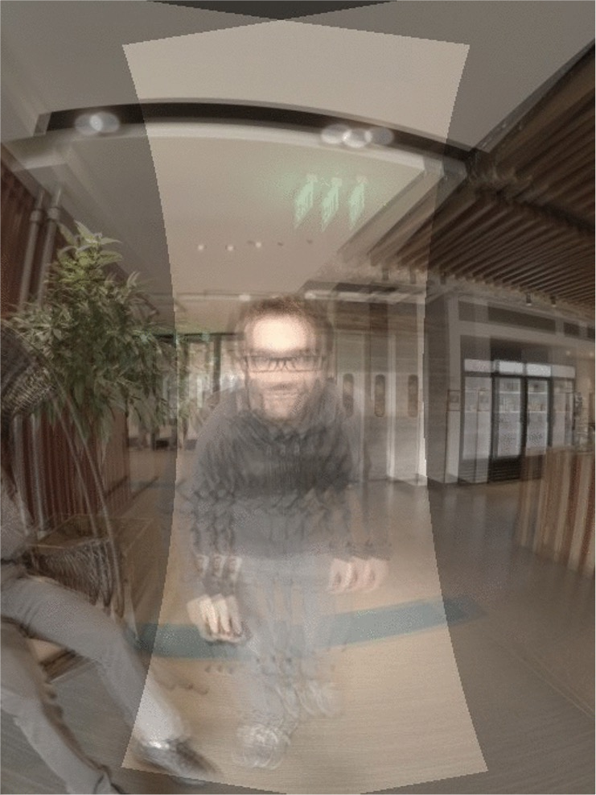
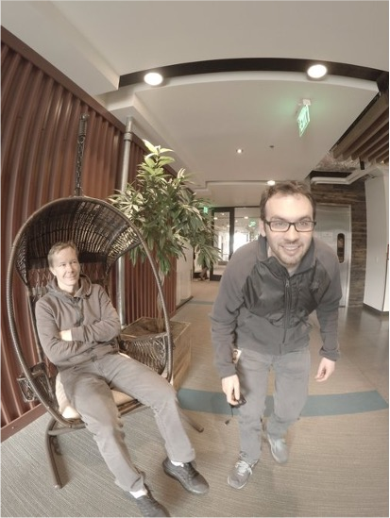
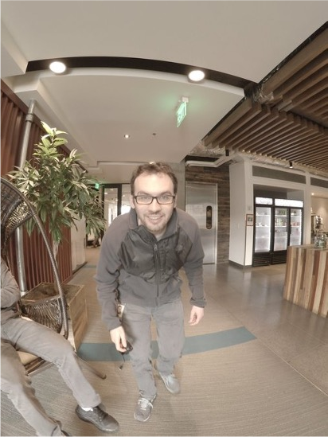
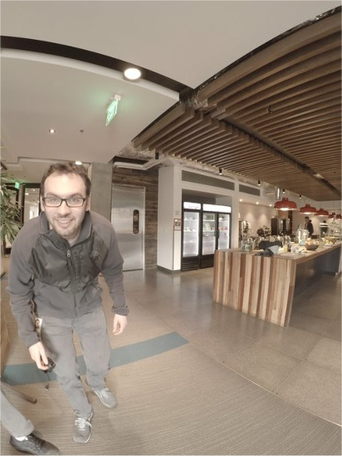
Another example
Left neighbor
Reference image
Right neighbor
Planar image reprojections swept over depth (averaged)

Slide 31




Cost Volumes -> Depth Maps
Plane sweep
Depth map solver
cost
(Belief propagation, graph cuts, etc.)
Reference image
Full cost volume
depth
Single pixel’s cost profile

Slide 32
Fusing multiple depth maps
Compute depth map per image
Fuse the depth maps into a 3D model
Figures by Carlos Hernandez

Slide 33



Another approach: NeRF
Represent scenes as functions from (x, y, z) to RGB and alpha (transparency), use volume rendering to render images
NeRF: Representing Scenes as Neural Radiance Fields for View Synthesis, ECCV 2020
https://www.matthewtancik.com/nerf

Slide 34
Questions?

